Slide 1

BUDAPEST DEEP LEARNING READING SEMINAR
‘WHAT TO DO IF WE DON’T HAVE ENOUGH DATA?’

Slide 2



I N T R O
LEVENTE
SZABADOS
"...originally Buddhist theologian and programmer, senior AI professional, lead of research, lecturer, startupper, ex-CTO
Presently:
Lecturer: Frankfurt School of Finance and Management,
Specialization leader: KÜRT Academy,
Senior Consultant: AI Partners,
Chief organizer: Budapest.AI."
CTCONTACT

Slide 3
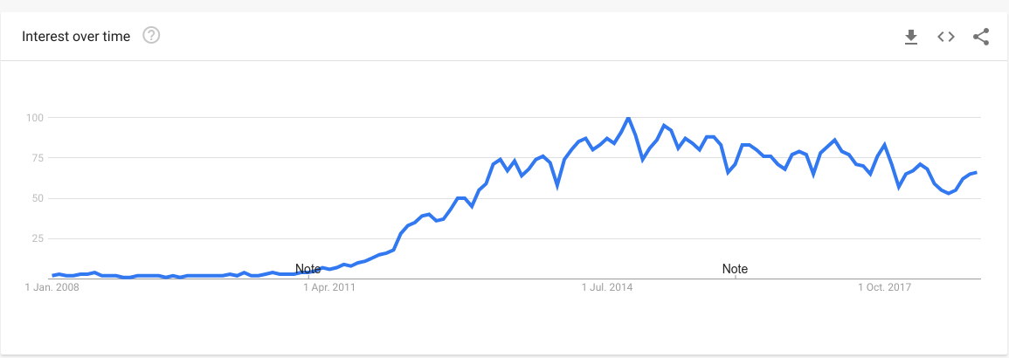

“B I T O V E R H Y P E D ? ”
BIG DATA IS - NOT EVERYTHING - IS BIG DATA!
D E T A I L S:
Google trends - Big Data topic 2008-2018
Chris Stucchio: “Don’t use HADOOP - Your data isn’t that big”

Slide 4
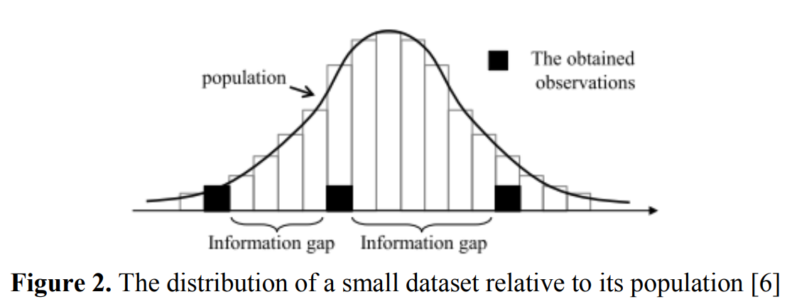
‘ N O T E N O G H I N F O R M A T I O N “
SMALL DATASETS VIOLATE BASIC ASSUMPTIONS
s o u r c e :
‘Handling a Small Dataset Problem in Prediction Model by employ Artificial Data Generation Approach: A Review’

Slide 5
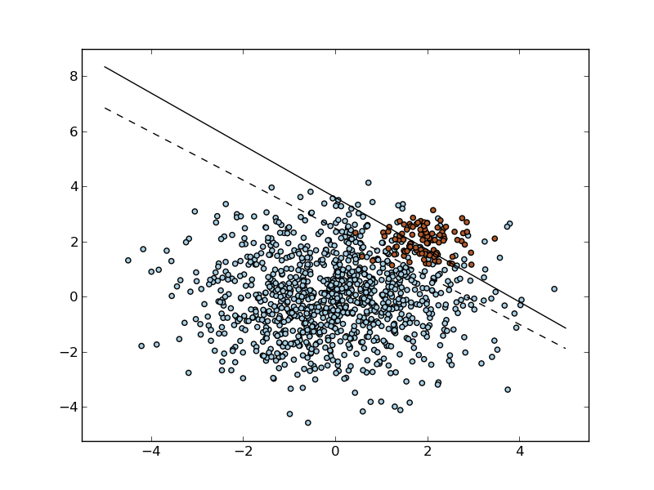
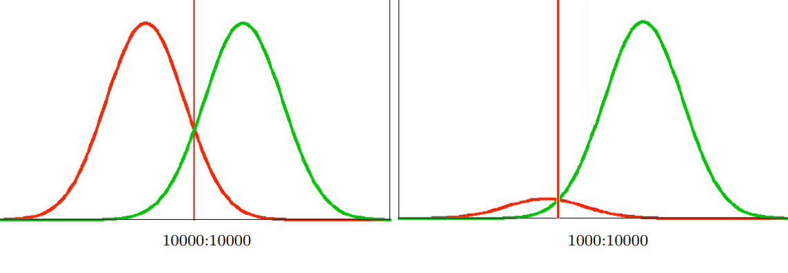
“ T H E B I A S N A M E D C L A S S I M B A L A N C E “
CASE I. - WE DON’T HAVE ENOUGH OF ONE THING
s o u r c e :
“Classification in imbalanced datasets”

Slide 6
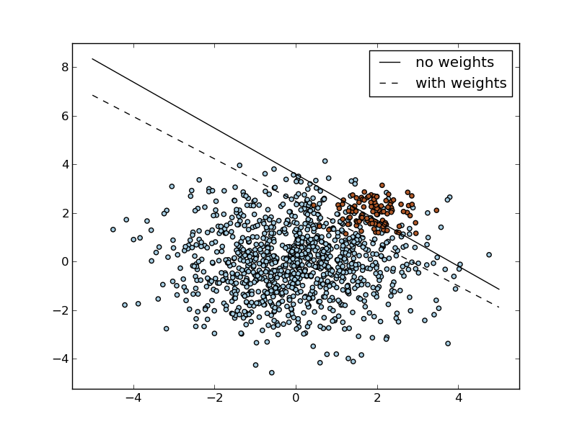
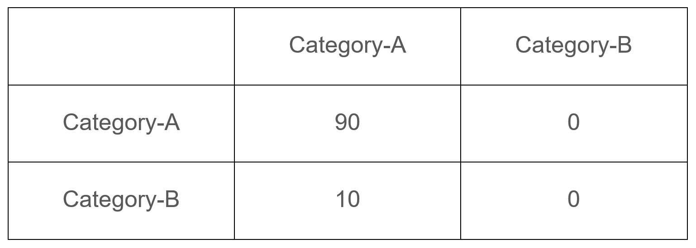
“ D A T A I S N O T C R E A T E D E Q U A L “
SOLUTION 1. - “COST SENSITIVE LEARNING”
Predicted
Actual
We can try to modify our objective / cost calculation to accomodate the fact, that making an errőr on the minority class is a “more serious issue”.
s o u r c e :
“Cost sensitive learning and the class imbalance problem”

Slide 7
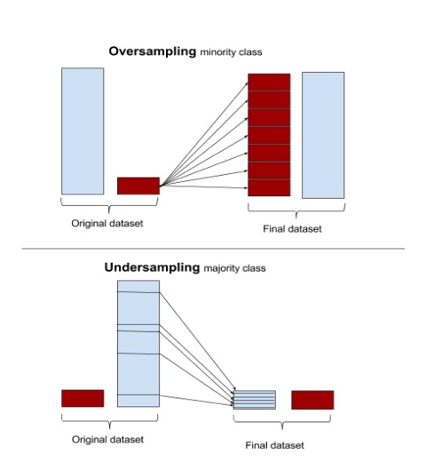
“ B I A S E D C O I N S F O R T H E W I N ! “
SOLUTION 2. - “SAMPLING”
Oversampling:
Repeatedly use some of the minority class datapoints
Good question is: Which ones?
Can we be more intelligent then random choice?
Undersampling:
Choose only some of the majority class datapoints
Reduces the overall dataset, not recommended
s o u r c e :
Undersampling and oversampling questions

Slide 8
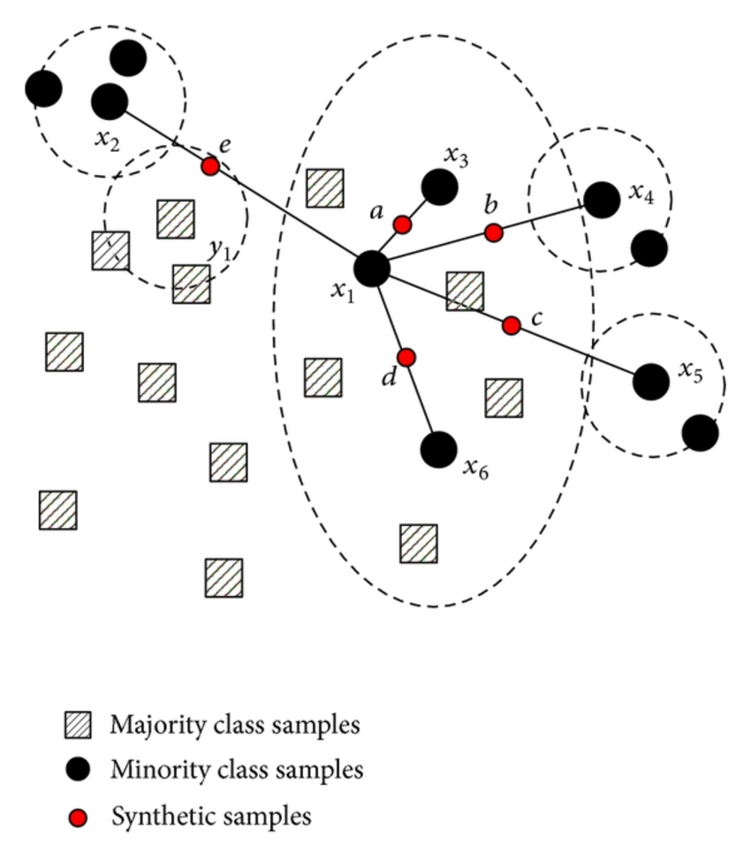
“ I F Y O U D O N ‘ T H A V E I T - C R E A T E I T “ “
SOLUTION 3. - DATA SYNTHESIS
Create new datapoints! (SMOTE)
“First it finds the n-nearest neighbors in the minority class for each of the samples in the class . Then it draws a line between the the neighbors an generates random points on the lines.”
...and add some noise! (ADASYN)
“After creating those sample it adds a random small values to the points thus making it more realistic. In other words instead of all the sample being linearly correlated to the parent they have a little more variance in them i.e they are bit scattered.”
...and use clusters! (Cluster Based Oversampling)
s o u r c e :
SMOTE and ADASYN
“Clustering and Learning from Imbalanced Data”
Notes:
THINK! We are doing something with the data distribution!

Slide 9
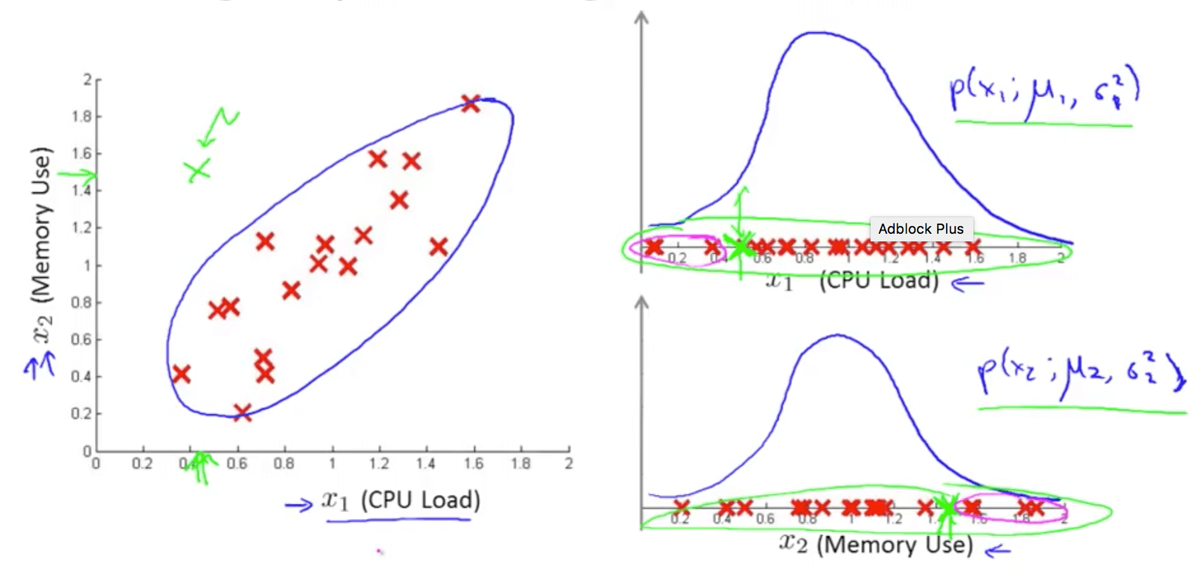
“ W E L L I F Y O U L O O K I T T H A T W A Y “
SOLUTION 4. - RECAST PROBLEM!
If the minority class points are so rare, they can be considered “exceptions”, or “anomalies”
There are tools for “one class” classification (eg.: “One class SVM” and “Isolation forests”)
But if we basically get a good probabilistic model of the majority class distribution, we are done.
This will lead us to “representation learning”
s o u r c e :
Classification based outlier detection techniques
Anomaly Detection using the Multivariate Gaussian Distribution
Ritchie Ng: Anomaly detection
Notes:
Don’t be mislead, we only need 1 gauss / feature

Slide 10
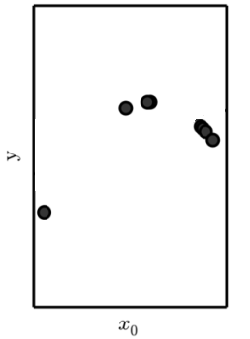
“ S I M P L Y : N O T E N O U G H D A T A
CASE II. - WE DON’T HAVE ENOUGH ANYTHING

Slide 11
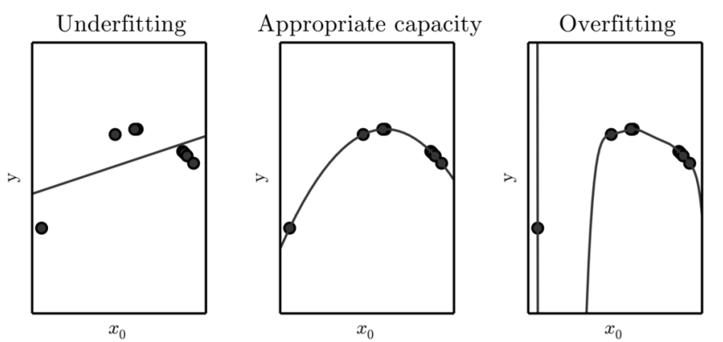
“ N O T E N O U G H I N W H A T S E N S E ? “
CONNECTION WITH OVERFITTING
s o u r c e :
Overfitting - Wikipedia
Notes:
with respect to the complexity of the model!

Slide 12
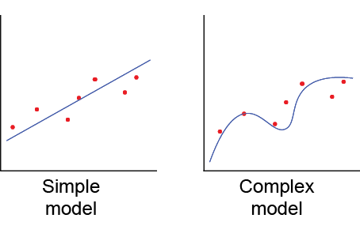
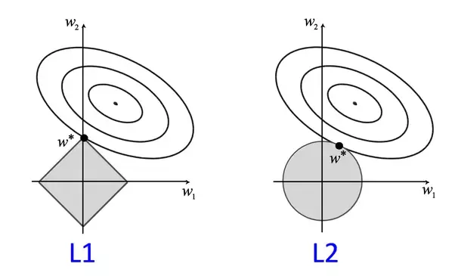
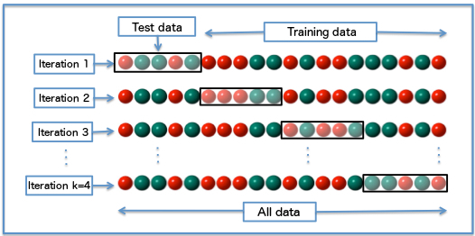
“ T R Y T H E C L A S S I C S F I R S T “
FIRST TRY - CLASSIC METHODS FOR STABILITY
Modify the model:
Use a simple model
We are often forced to use a complex one since the data itself is complex (dimensions, non-linearity…)
Use special models (eg. SUFTware)
Modify the objective:
Add regularization term (Capacity control)
Use “max margin” objective (like in SVMs)
Modify the training:
Use crossvalidation for getting a bit more out of the data
Use PU Learning

Slide 13
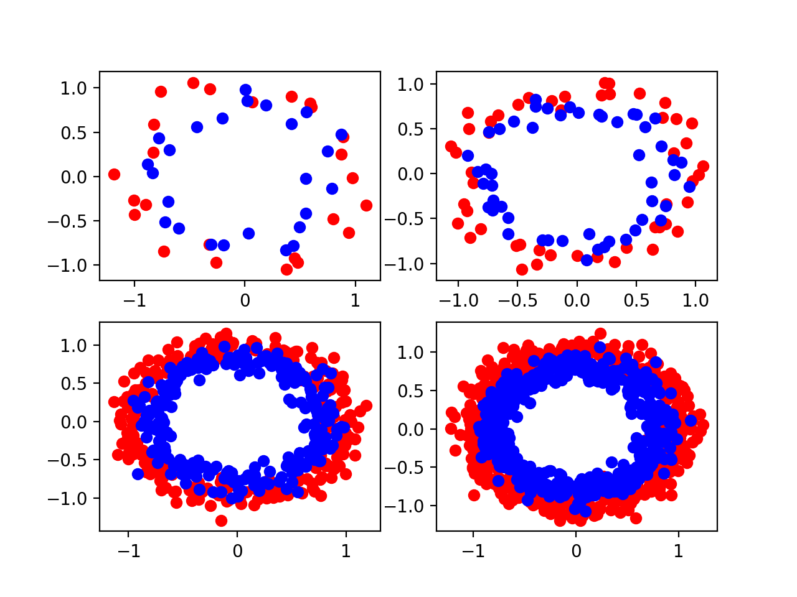
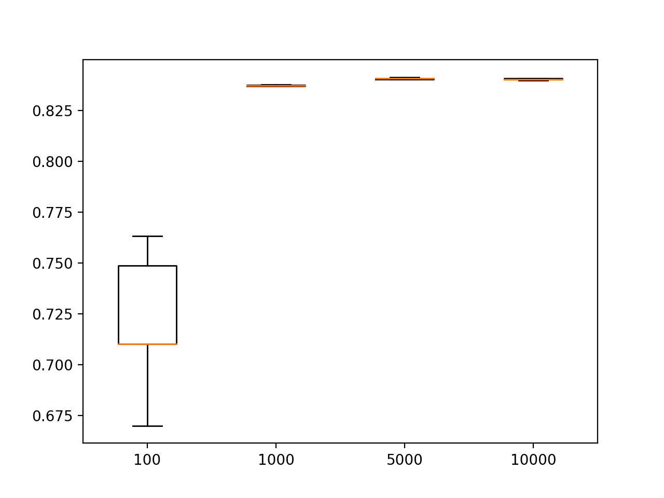
“ T H E M O R E T H E M E R R Y E R “
HOW MUCH IS “ENOUGH” FOR A SMALL NEURAL NET?
"...two inputs, 25 nodes in the hidden layer, and one output..."
s o u r c e :
Jason Brownlee: “Impact of dataset size on deep learning model skill and performance estimates”

Slide 14
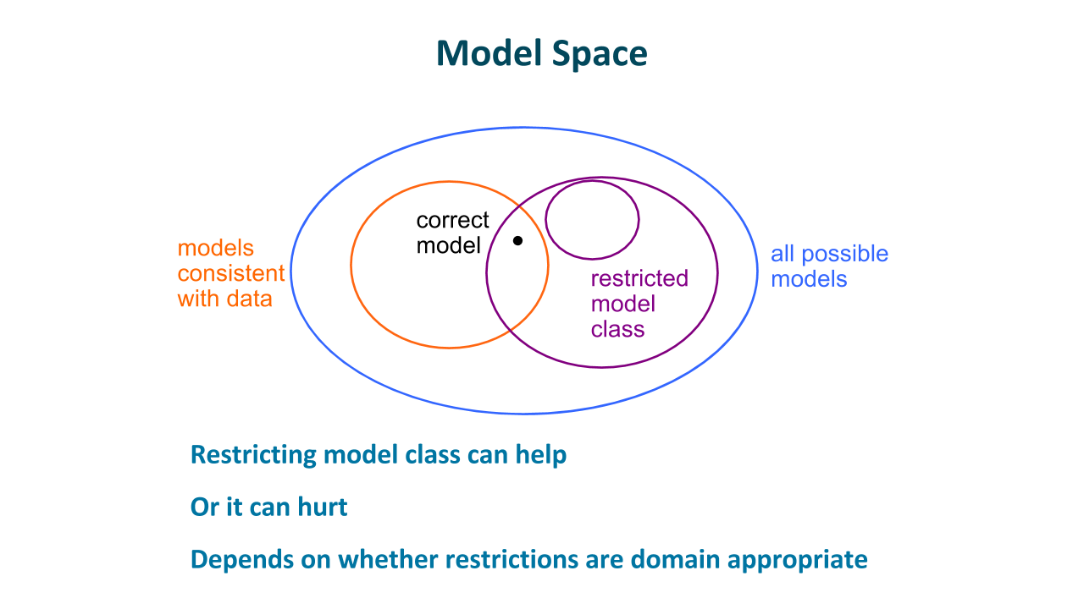
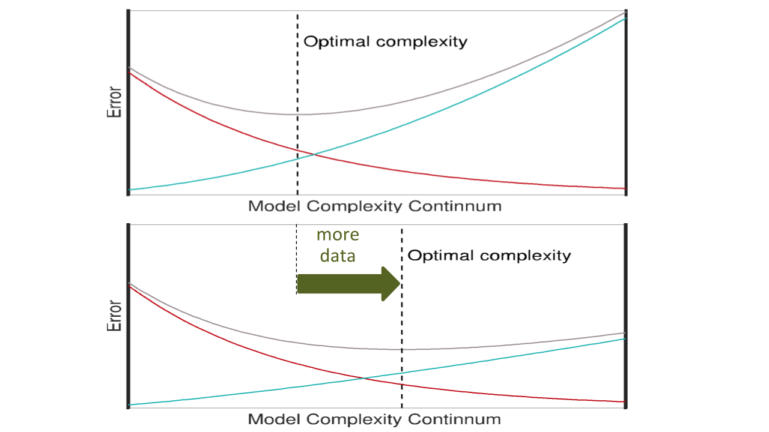
“ T H E M O R E T H E M E R R Y E R “
REMARK: ADDING MORE DATA ACTS AS “REGULARIZER”
s o u r c e :
“Lecture series of Michael C. Mozer at DeepLearn2017 Bilbao”

Slide 15
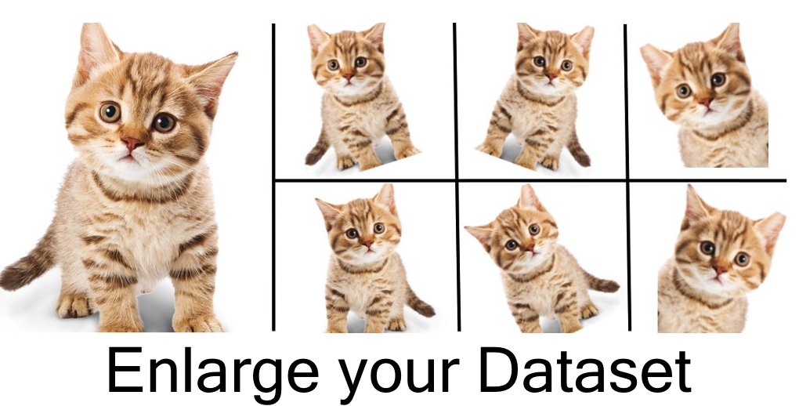
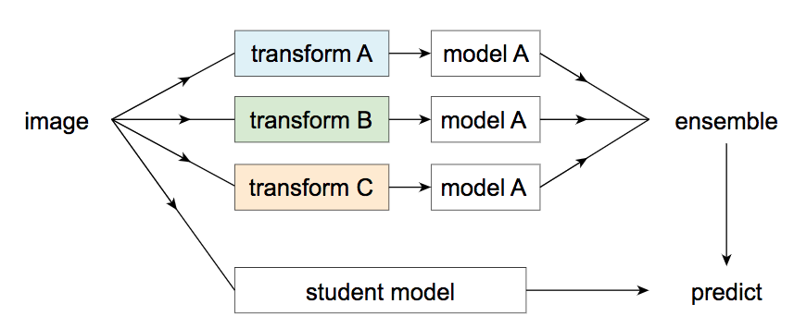
“ T H E M O R E T H E M E R R I E R “
GET MORE “DATA” 1. - GENERATE OR AUGMENT
Data augmentation:
Use simple operations to modify the data
Images: rotate, mirror, crop,...
MUST be realistic for the domain distribution
“Self labeling”:
Transform data, train subclassifiers, use them on new data, add predictively labelled data to original.
Weak supervision:
Can be, that labels wil be noisy - crowdsourcing
s o u r c e :
“Data augmentation - How to use Deep Learning when zou have limited data?”
“Data distillation: Towards omni-supervised learning”
“A brief introduction to weakly supervised learning”
“The Quiet Semi-Supervised Revolution”
Notes:
Transformations MUST fall inside the data distribution - at least to respect it’s constraints!!!

Slide 16
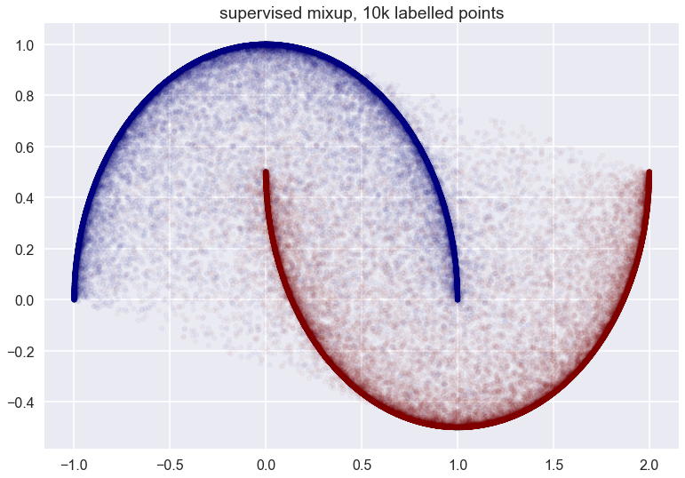
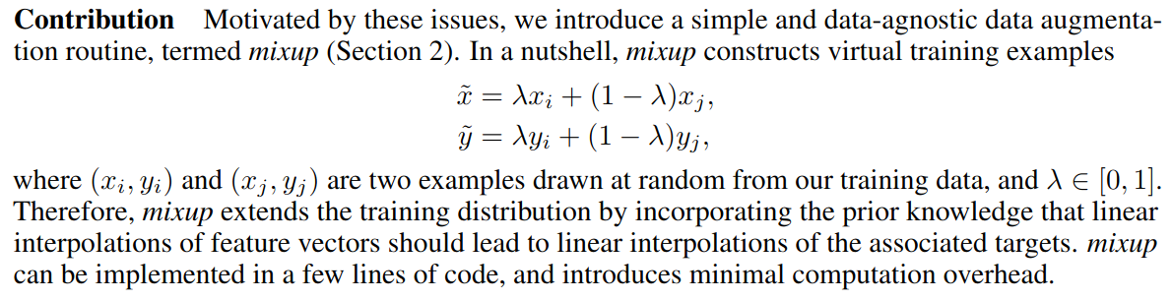
“ L E A R N T H E D I S T R I B U T I O N ! “
GET MORE “DATA” 1.1 - “MIXUP”
The idea of “Mixup”:
Approximates a whole distribution!
s o u r c e :
Mixup: Beyond empirical risk minimization
Mixup: Data-dependent Data Augmentation (analysis by inFERENCe )”
Notes:
Transformations MUST fall inside the data distribution - at least to respect it’s constraints!!!

Slide 17
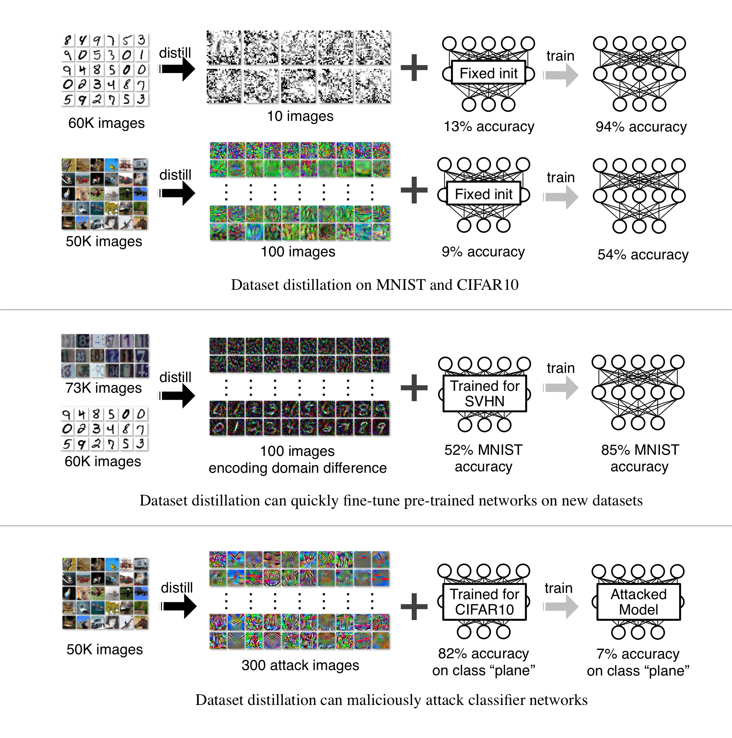
“ N O T A L L D A T A I S E Q U A L ! “
SIDENOTE: DATASET DISTILLATION
“...The idea is to synthesize a small number of data points that do not need to come from the correct data distribution, but will, when given to the learning algorithm as training data, approximate the model trained on the original data. For example, we show that it is possible to compress 60, 000 MNIST training images into just 10 synthetic distilled images (one per class) and achieve close to original performance with only a few steps of gradient descent, given a particular fixed network initialization”
WTF????
s o u r c e :
Dataset Dstillation

Slide 18
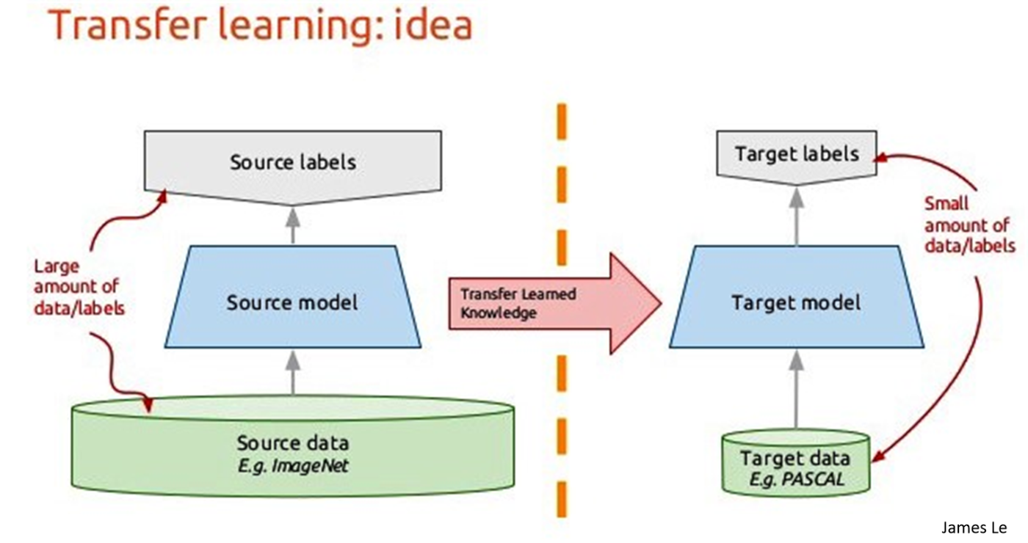
“ T H E K N O W L E D G E R E S I D E S W I T H I N “
GET MORE “DATA” 2. - TRANSFER IT! (COMPRESSED)
Transfer learning!
A HUGE topic in itself (with more and more spohisticated methods for preventing “catastrophic forgetting”)
We have to see, that models are “storing” data, albeit compressed.
There are plenty of pre-trained models available, USE THEM!
What model to “transfer”?
Notion of “learning a whole representation space” (see eg.: Mixup method)
GANs or VAEs are generally strong candidates (+ few labeled data case)
s o u r c e :
“Transfer Learning - Machine Learning's Next Frontier”
“”Data Augmentation in Emotion Classification Using Generative Adversarial Networks”

Slide 19
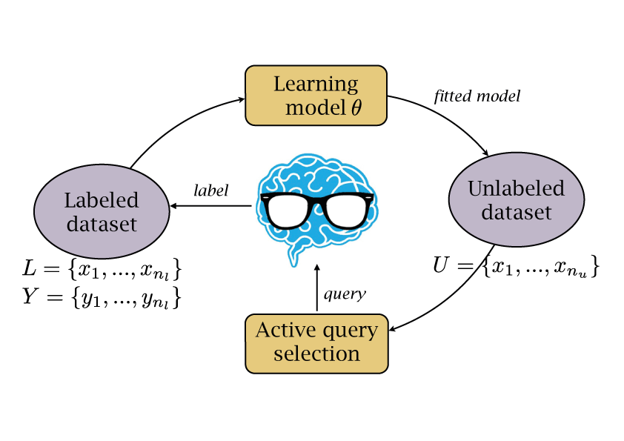
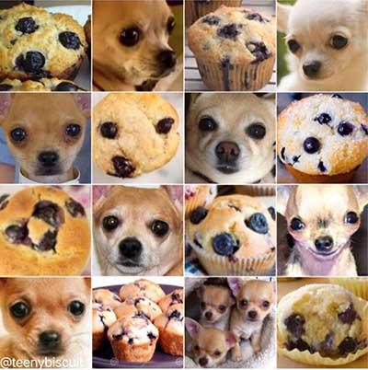
“ P L E A S E ? “
GET MORE “DATA” 3. - ASK FOR IT! :-)
Crowdsource!
Amazon Mechanical Turk
or CrowdFlower.
Design a learning loop!
Continuous, Online learning
There are key points worth
asking for
(margin, adversarial examples)
-> Active learning
-> Building Models via Comparisons
s o u r c e :
“Adversarial sampiing for active learning”
“Atacking machine learning with adversarial examples”
“ModAL - Active learning with Keras”

Slide 20

MEASUREMENT VS BUSINESS RISK
THE FALSE FOCUS ON ACCURACY
“I HAVE 90% ACCURACY!”
CLASSIFICATION RISK:
“Your cancer predictions are 90% accurate.
We have 10 dead people.”
SOLUTION:
Substitution of huiman expertise is not the way!
Think in cooperative systems!

Slide 21

DON’T REPLACE, AUGMENT!
COOPERATIVE SYSTEMS ARE MINIMIZING RISK
Artificial intelligence VS Augmented intelligence

Slide 22
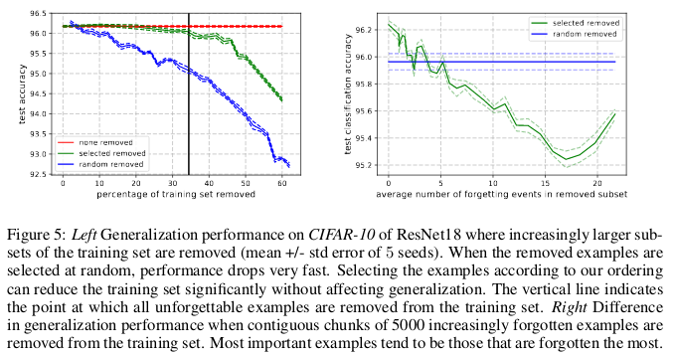
“ E P I L O G U E 1. “
WHAT IF WE DON’T NEED THAT MUCH DATA AT ALL?
"A forgetting event happens when the neural network makes a misclassification (of a sample) at time t+1, having already made an accurate classification at time t,
"...find that 91.7% of MNIST, comprise of unforgettable examples."
"Unforgettable examples, ... encode mostly redundant information … removing the most unforgettable examples.
On CIFAR-10, 30% of the dataset can be removed without affecting test accuracy"
s o u r c e :
“An Empirical Study of Example Forgetting during Deep Neural Network Learning”
‘Seven Myths in Machine Learning Research’

Slide 23
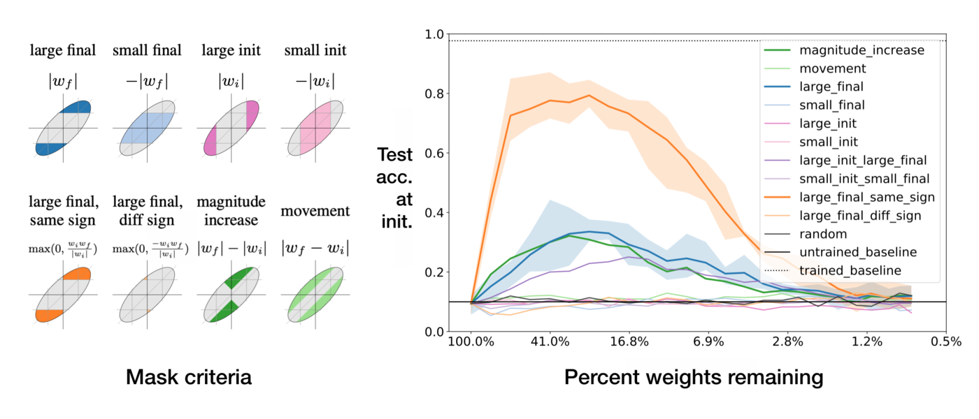
“ E P I L O G U E 2. “
WHAT IF WE DON’T NEED THAT BIG MODELS AT ALL?
There are winning “lottery tickets”, that is: subnetworks with high performace on initialization!
Seems like much of the performance of large networks comes from these subnetworks
If we prune large networks, keeping these “winners”, performace can even increase (or not decrease much)
The subnets can be found by only keeping those weights that move away from zero during training
s o u r c e :
‘The Lottery Ticket Hypothesis: Finding Sparse, Trainable Neural Networks’
‘Deconstructing Lottery Tickets: Zeros, Signs, and the Supermask’

Slide 24

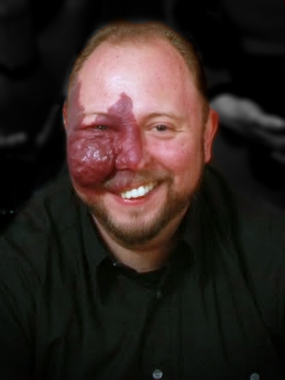
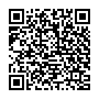
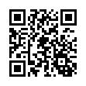
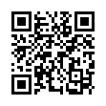
T H A N K S F O R T H E A T T E N T I O N !
LET’S CONTINUE!
PRESENTATION
COMMUNITY
MYSELF
Notes:
Feature engineering as data augmentation, see the view of https://github.com/firmai/deltapy
https://www.linkedin.com/feed/update/urn:li:activity:6536584782040580096
https://www.lyrn.ai/2019/01/29/identifying-and-correcting-label-bias-in-machine-learning/
Class imbalance ensemble learning based on margin theory
https://res.mdpi.com/applsci/applsci-08-00815/article_deploy/applsci-08-00815.pdf?filename=&attachment=1
https://divamgupta.com/unsupervised-learning/semi-supervised-learning/2019/05/31/introduction-to-virtual-adversarial-training.html
https://bair.berkeley.edu/blog/2019/06/07/data_aug/
data valuation https://arxiv.org/pdf/1902.10275.pdf
robust classifier http://gradsci.org/robust_apps?fbclid=IwAR1Aary1M4nMuMScD4yByu6r0SpPUhn0ZtisJTCEK69s5G5z_cIAp1qCeE4

